Slide 1
Recommendation Systems
By Vamsi Chinta, Faraz Mirza, & Alejandro Benitez

Slide 2
What are Recommendation Systems?
Recommendation systems are algorithms that uses data to predict the most useful and relevant information
The Desired Goals for the predictions:
Relevance `useful`
Novelty `new to user`
Serendipity `new to the trend`
Diversity `complete coverage`
Notes:
https://towardsdatascience.com/the-remarkable-world-of-recommender-systems-bff4b9cbe6a7

Slide 3
Main Approaches
Knowledge-based Systems | “Tell me what fits my needs”
Content-based Filtering | “Show me more of what I’ve liked”
Collaborative Filtering | “Show me more of what similar people have liked”
Hybrid Recommender Systems |”Show me more of what I and similar people have liked”

Slide 4
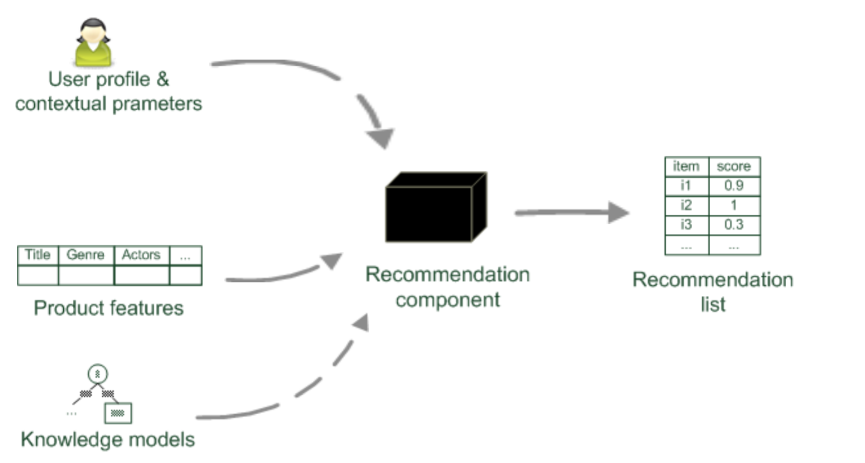
Knowledge-Based Systems
This Approach relies on the inferences about a user’s preferences and needs
Notes:
https://medium.com/@jwu2/knowledge-based-recommender-systems-an-overview-536b63721dba

Slide 5
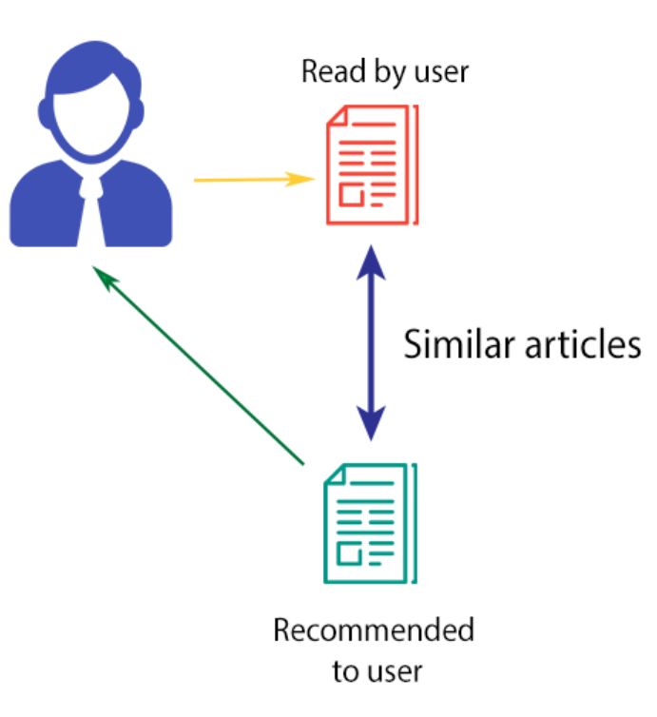
Content-Based Filtering
This Approach relies on the similarity of the items being recommended.
The basic idea is that if you like an item, then you will also like a “similar” item.

Slide 6
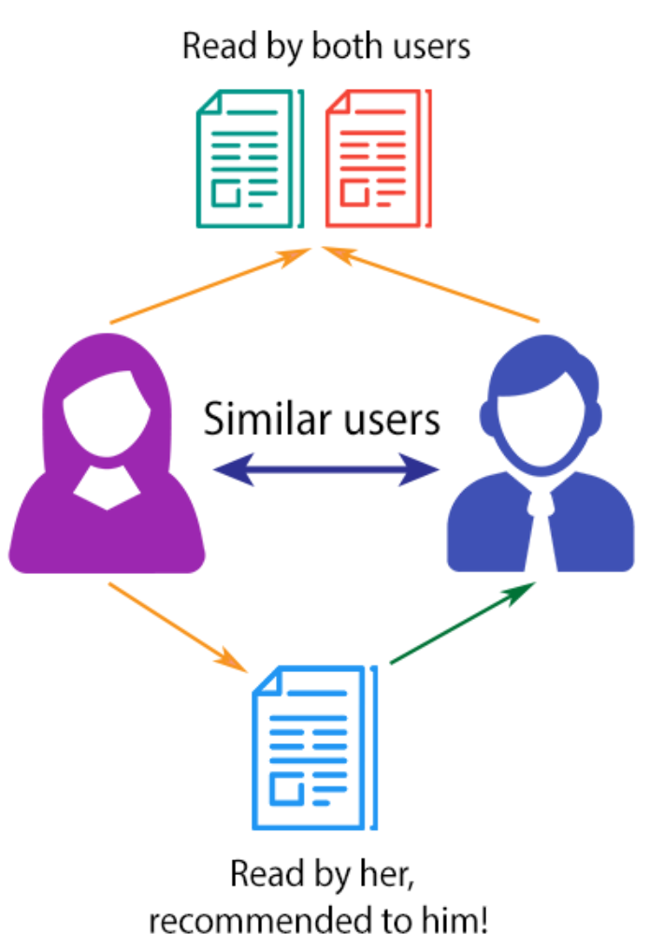
Collaborative Filtering
This Approach relies on the similarity of the users it recommending to.
The basic idea is that if someone who is similar to you likes an item, then you will also like that same item.

Slide 7
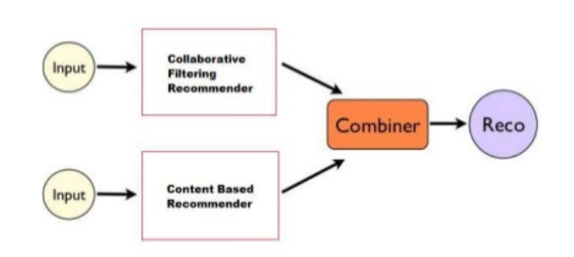
Hybrid Systems
This approach combines two or more recommendation strategies in different ways to benefit from their complementary advantages.

Slide 8
Comparison
Type | Pros | Cons
Knowledge-Based Systems | Assured Quality | Static and Costly
Content-Based Filtering | does not rely on user’s preferences | low on novelty can’t handle contradictory preferences from users
Collaborative Filtering | gets better as the data evolves | Sparsity problems cold start problems
Hybrid Systems | mitigates only a portion of the combined approaches shortcomings | most datasets do not allow to compare different recommendation paradigms

Slide 9
Limitations
Cold-Start Problem - no data for making predictions
Sparsity - insufficient data
Scalability - too much data
Privacy Protection - recommendations too personal
Over-Specialisation - no surprise element
GraySheep Problem - contradictory data
Shilling Attacks - fake data

Slide 10
Process Flow
1
2
3
4
5
Input Data
Preprocessing
Recommendation Scoring
Neighborhood Generation
Output
Structure the data appropriately
Matrix factorization into latent space
Auto-Encode
compute similarity scores, cooccurrences or conditional probabilities
KNN
Association Rules
Recommendations

Slide 11
Feature Extraction
Complex features can be extracted using neural networks from product images, videos, and audio to be included in modeling.
These types of features can significantly improve recommendations as many users make decisions based on visual information

Slide 12

Image Similarity
Using Image embeddings obtained through Convolutional Neural Network, we can extract high (product type) and low level (texture/style) similarities between items.

Slide 13
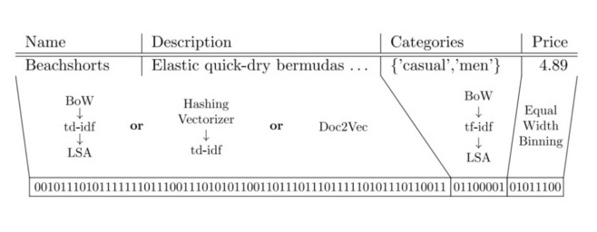
PreProcessing
Auto Encoder- an artificial neural network used to learn a compressed representation of large data, in this case a large sparse matrix. Auto Encoding reduces the dimensionality.

Slide 14
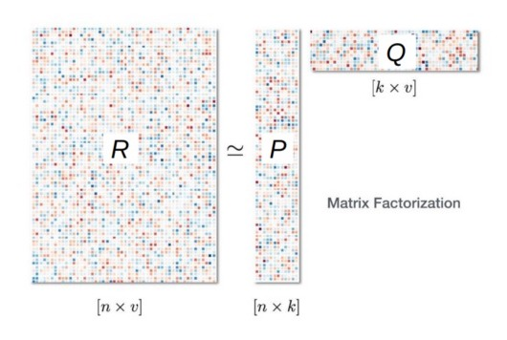
PreProcessing
Matrix Factorization-Algorithm for decomposing user-item interaction matrix to two or more lower dimensional matrices with k latent components.

Slide 15
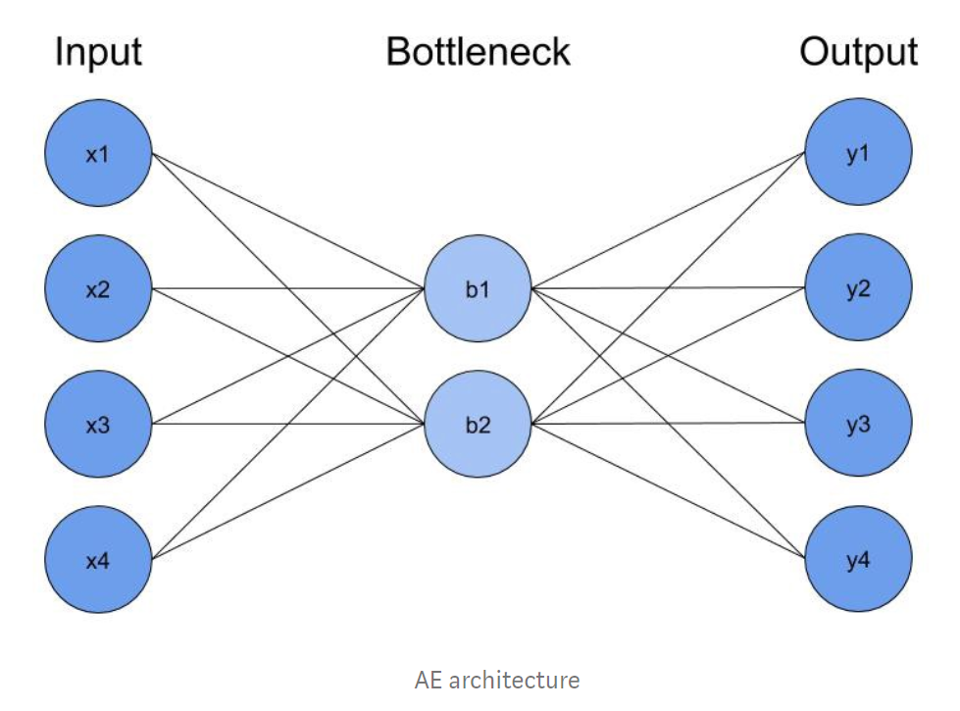
Deep learning RecSys
Matrix Factorization gives a flat latent space, in comparison deep learning allows the use of higher dimension latent space for more complex relationships between user-item interactions.
Deep learning allows for training of auto encoders together with matrix factorization.
These advantages of deep learning over traditional methods have reduced classification error by more than 24% over the past few years.

Slide 16
Neighborhood Generation
KNN
Pearson Correlation
Spearman Correlation
Cosine Similarity
Association Rules
Conditional Probability
Cooccurrences
Associations

Slide 17
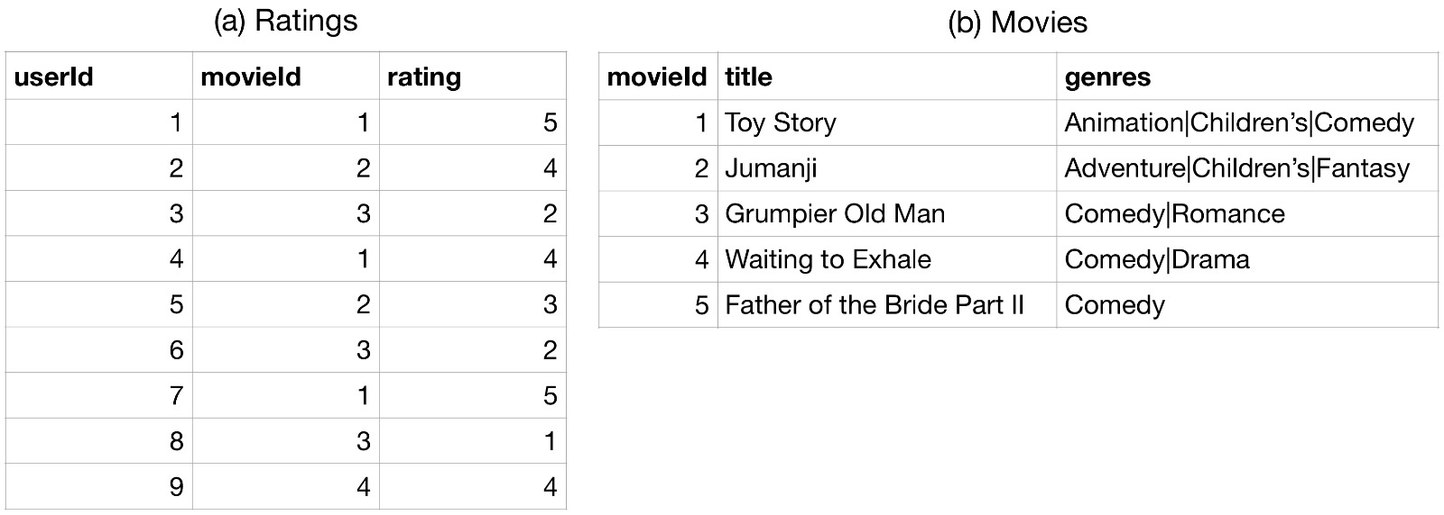
Movie Data and User Ratings

Slide 18
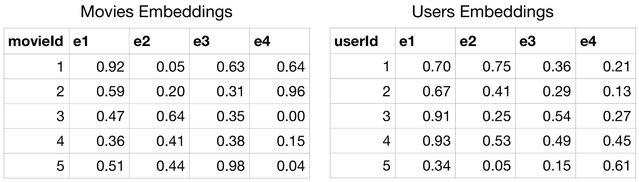
Matrix Factorization

Slide 19
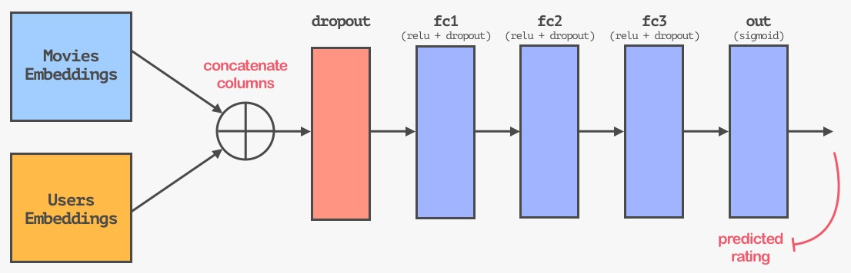
Neural Network Architecture

Slide 20
Evaluation Metrics
Accuracy
‘measure of how well the predictions are’
Coverage
‘measure of what portion of your items are being recommended’
Precision
‘measure of how many predictions were correct’
Recall
‘measure of how many predictions were found’’

Slide 21
Questions?

Slide 22
References
https://www.sciencedirect.com/science/article/pii/S0957417412002825
https://arxiv.org/pdf/1606.07792.pdf
https://arxiv.org/pdf/1409.2944.pdf
https://arxiv.org/pdf/1909.03999.pdf
http://delivery.acm.org/10.1145/2850000/2843948/a13-gomez-uribe.pdf?ip=108.210.179.40&id=2843948&acc=OA&key=4D4702B0C3E38B35%2E4D4702B0C3E38B35%2E4D4702B0C3E38B35%2EE5B8A747884E71D5&__acm__=1570214488_eb2ebebe0a64a8a0e1440ec4a4dd7cc5
https://medium.com/recombee-blog/machine-learning-for-recommender-systems-part-1-algorithms-evaluation-and-cold-start-6f696683d0ed
https://medium.com/recombee-blog/machine-learning-for-recommender-systems-part-2-deep-recommendation-sequence-prediction-automl-f134bc79d66b
https://medium.com/@iliazaitsev/how-to-implement-a-recommendation-system-with-deep-learning-and-pytorch-2d40476590f9
https://pdfs.semanticscholar.org/5d1d/d378962c7601526f65f69e408f8800a0d3c4.pdf

Slide 23
Appendix

Slide 24
Association Rules
Find co-occurrences and aims at detection of rules such as:
“If a customer purchases beer then he also buys diapers in 70% of the cases”
X(Beer) -> Y(Diapers) from a set of transactions D = {t1, t2, .., tn)
Measure of Quality: Support and Confidence are used as a threshold to cut off unimportant rules
Support = P(X U Y)/ |D|, Confidence = P(X U Y)/ P(X)

Slide 25
Data Process Flow
Input Data
User and item data based on user feedback
User-Item interaction Matrix
Matrix representation of user affinity for item, sparse by nature
Matrix Factorization
Algorithm to decompose matrix into two rectangular lower dimensionality matrices
Recommendation Data
Latent Space of possible recommendations
Recommendation
Optimal Recommendation Selection
Notes:
https://towardsdatascience.com/paper-summary-matrix-factorization-techniques-for-recommender-systems-82d1a7ace74
Input data
User-Item interaction Matrix
Matrix Factorization
Recommendation Data
Recommendation

Slide 26
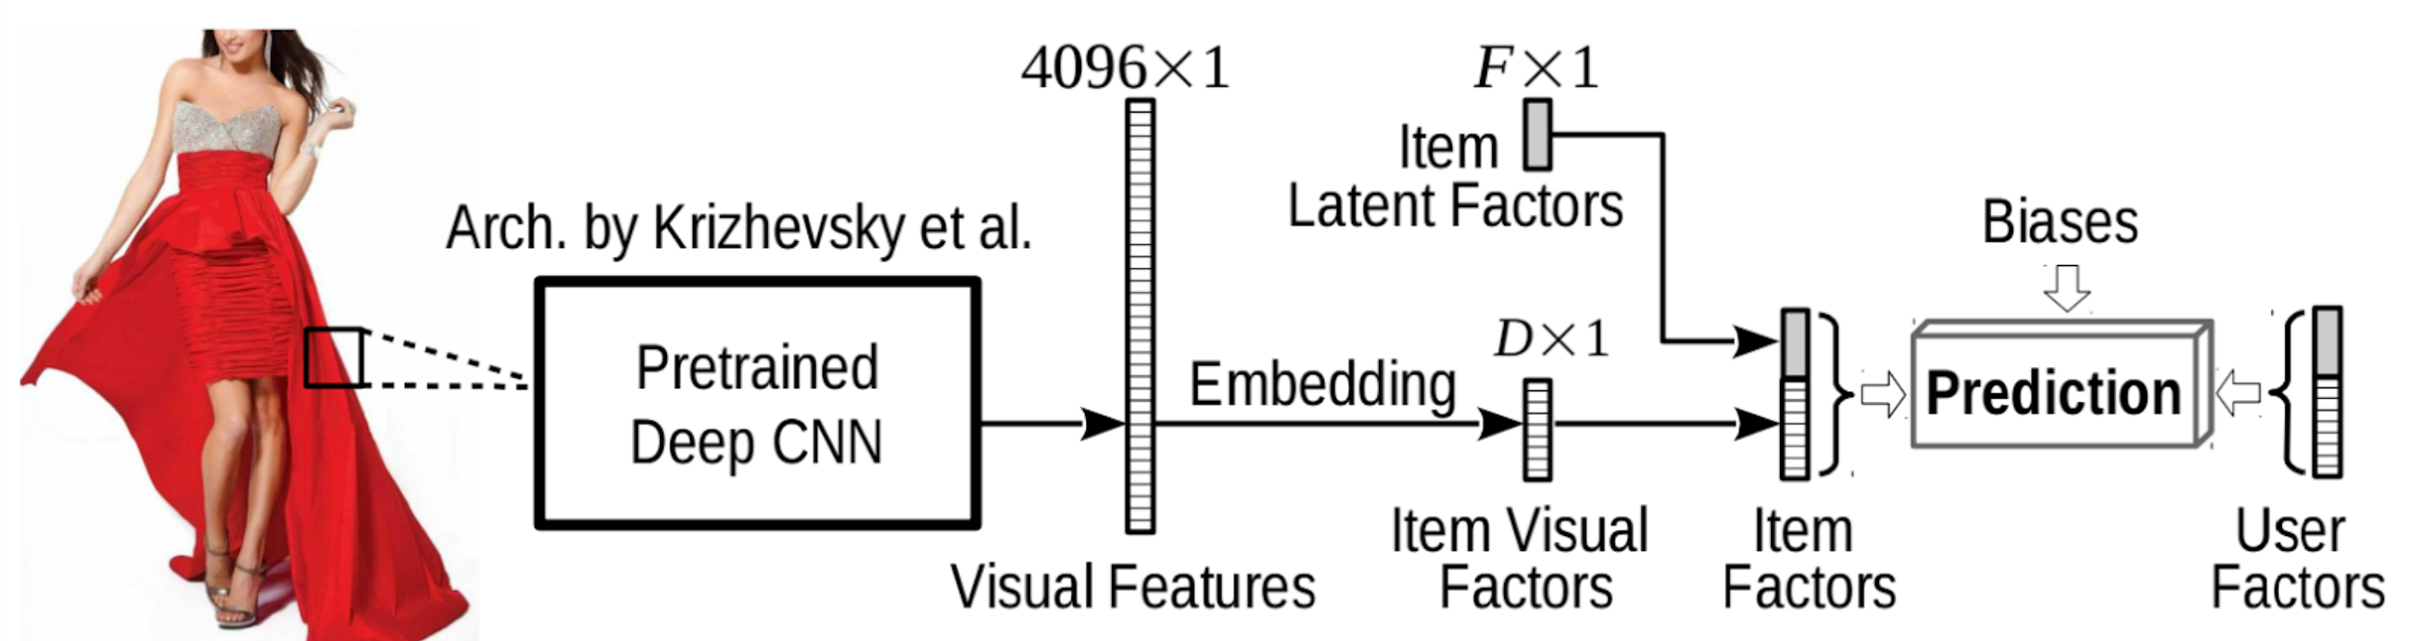
Feature Extraction

